Slide 1
Teamwork Presentation
Team “DATE” @ Java Basics Course Sept 2014

Slide 2
Purpose and Objectives
To design and implement a game “PING PONG” with basic coding skills at JAVA
To set up a good teamwork, based on team management and collaboration for the period of 1 week
Each member should be able to prove his/her contribution at the project

Slide 3
Team Organization
Nikolay Raychev
Nelly Mincheva
Yordan Georgiev
Lyudmil Nikodimov
Aleksandar Dimitrov

Slide 4
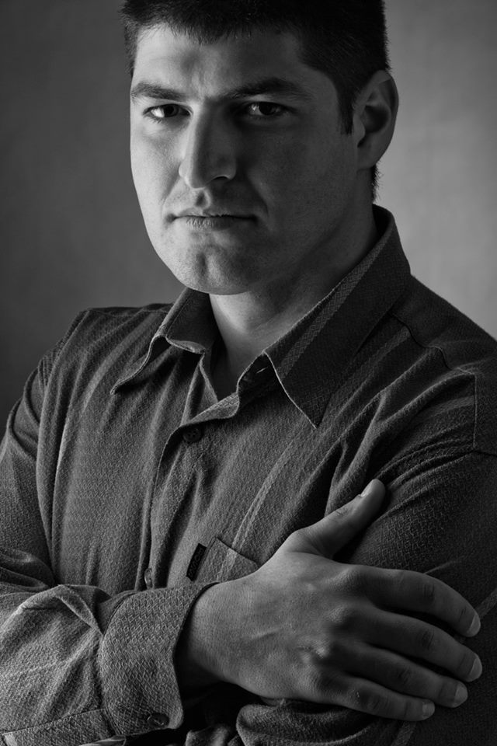
Roles and Responsibilities
Team Leader
Nikolay has coordinated and helped out each member of the team
He has created the GUI and the main menu of the JAVA-based game

Slide 5
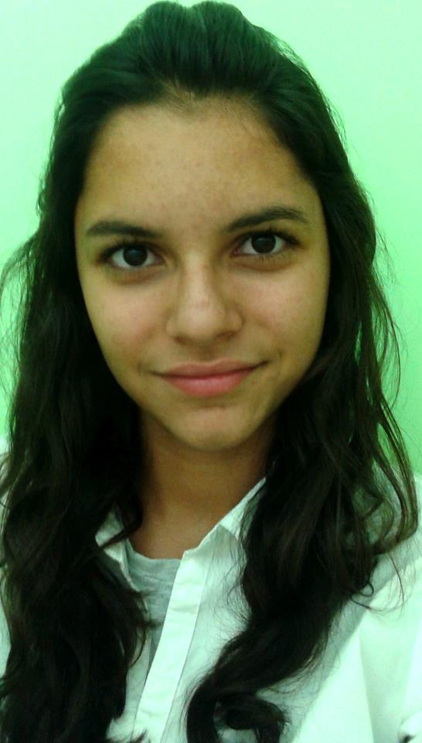
Roles and Responsibilities
Team Contributor
Nelly has restricted the ball movement in the Jframe and have added scores panel

Slide 6
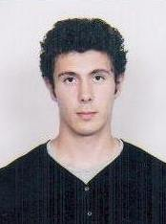
Roles and Responsibilities
Team Contributor
Danny was responsible for the implementation and setting up the parameters of game pause

Slide 7
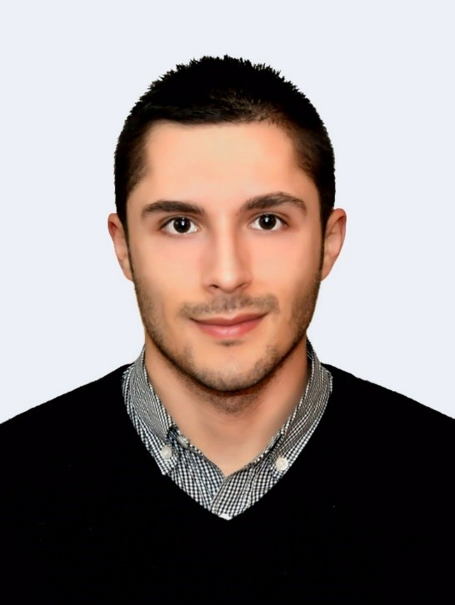
Roles and Responsibilities
Team Contributor
Lyudmil has restricted the movement of the sticks and has implemented the AIPaddle movement

Slide 8
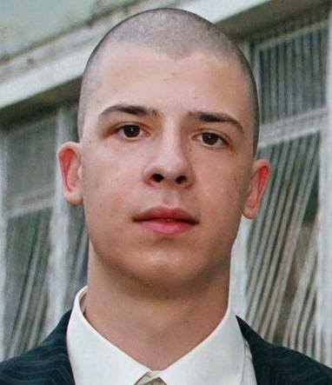
Roles and Responsibilities
Team Contributor
Sasho has implemented the sound effects and has upgraded the ball movement
He also helped out the other team member

Slide 9
For more information
If you have interest on our game, you are free to testing it at:
https://github.com/nellymin/PingPong/tree/master/PingPong/PingPong
Enjoy our game, keep calm and never stop learning and coding ☺

